Slide 1
Recap of Class 10
Discussed Court’s approaches to defining “officers,” “principal” v. “inferior” officers, and “employees”
Arthrex: Rendering adjudicative decisions that represent the “final word” of the executive branch is inconsistent with the status of “inferior” officer
Highlighted Arthrex’s chain of command theory and the uncertainty surrounding interbranch appointments
Discussed actual holding of Myers and Taft’s historical and functional arguments for a broad reading of POTUS removal power

Slide 2
Putting Together Myers
Holding and Dicta
Congress may not insist on a Senate role in removing PAS appointees
Status of Officer | Taft’s View on Removability by the President
Principal Officer | Must be removable at will
Inferior officer appointed by the President with advice and consent | Must be removable at will
Inferior officer appointed by the President unilaterally | Leans towards removal at will, but leaves it undecided
Inferior officer appointed by heads of departments or courts | Removal power goes with appointing official and may be limited by statutory conditions

Slide 3
Humphrey’s Executor
Congress held to be allowed to limit the President’s removal power over FTC members to good cause
Unanimous decision of an ideologically diverse, intellectually heavyweight Court
Court’s framework – puzzling language on 187
  Postmaster = purely executive (no legislative or judicial power)
  FTC has quasi-leg powers and quasi-judicial powers
  Myers limited to purely executive officers

Slide 4
Unraveling the Puzzle?
“Such a body cannot in any proper sense be characterized as an arm or an eye of the executive. Its duties are performed without executive leave, and, in the contemplation of the statute, must be free from executive control. To the extent that it exercises any executive function -- as distinguished from executive power in the constitutional sense -- it does so in the discharge and effectuation of its quasi-legislative or quasi-judicial powers, or as an agency of the legislative or judicial departments of the Government.”

Slide 5
Analyzing Bowsher [192]
Under statute, CG could be removed either by impeachment (House majority + 2/3 of Senators) OR by statute (majority of both Houses + President OR 2/3 of both Houses after a veto)
President’s legal obligations can only be created by:
  Congress (through legislation)
  Courts
  Officers of the United States

Slide 6
Congress’s Plea
Why read the constitutional provision of impeachment power as EXCLUSIVE when:
  The Constitution does not explicitly state that Congress has no other means of removing officers of the United States from their position
  The Constitution allows Congress to make all laws N & P for carrying into execution ANY powers vested in the government
  No real showing of aggrandizement in practice (functionalism)
Court rejects—Congress cannot make binding policy by controlling executive functions through removal leverage over officers

Slide 7
Independent Counsel Provisions
Applies to cabinet and other high-level political officials and chair of the President’s election campaign
If the AG got specific info that a covered official had committed a nontrivial federal offense (felony), the AG would 90 days to investigate
  AG can decide there’s no need for further investigation, there is a basis for prosecution, or “I don’t know”
  Whatever AG decides is not subject to judicial review
If the AG does anything other than the first. AG is required to apply to a special panel of the U.S. Court of Appeals for the DC Circuit to appoint an independent counsel

Slide 8
Good Cause Removal of IC
  An independent counsel appointed under this chapter may be removed from office, other than by impeachment and conviction, only by the personal action of the Attorney General and only for good cause, physical or mental disability (if not prohibited by law protecting persons from discrimination on the basis of such a disability) or any other condition that substantially impairs the performance of such independent counsel's duties.

Slide 9
Olson’s Removal Argument
Limitation on President’s power to fire Morrison is unconstitutional because criminal prosecutors are executive officers who must be subject to plenary policy control by the President
  Court rejects this claim too
  Test = whether removal restriction impedes the President’s capacity to fulfill his constitutional function (198)

Slide 10
Test on removability = whether removal restriction impedes the President’s capacity to fulfill his constitutional function
Olson’s argument = President functions =
  Takes care that the laws be faithfully executed
    Court: Good cause provision for removal assures that the President, through the AG, can take care that the IC faithfully execute the laws (199)
  Conducts criminal prosecutions because of the vesting in the President of “executive power”
    Court: “We simply do not see” that controlling the discretion of the independent counsel is central to the constitutional functioning of the executive branch (198-199) – draws analogy to civil “prosecutions”

Slide 11
Two Opinions NOT Written
Balancing Approach to the Separation of Powers
  When one branch of gov’t is challenged for interfering with the function of another, it’s sometimes OK if (a) interference is narrowly tailored to accomplish (b) some essential purpose that the “aggressor” branch is entitled to pursue
    Even if EGA interferes with prosecutorial discretion that is ordinarily subject to presidential control, the statute is justified because it is narrowly tailored to respond to a set of contexts in which Congress could reasonably fear that conflicts of interest within the executive would impede faithful execution of the laws (See Watergate)
Historical analysis of the role of criminal prosecutors
  As the founders understood criminal prosecution, the prosecutorial power was not part of a basket of powers that they would have labeled unambiguously “executive” in the sense that, if someone is vested with executive power, that power would have to include criminal prosecution

Slide 12
What Morrison v. Olson implies about the prosecutorial function
Prosecutor, as an administrator, has two components to her job
  Following the law (Presidents can make sure that officers faithfully follow the law if they can fire the officers for not following the law)
  Exercising discretion
    Is the discretion exercised by the inferior officer discretion that the CONSTITUTION vests in the President or is it discretion that resides in the officer because of CONGRESS?
      Discretion connected with criminal prosecution is NOT constitutionally vested in the President

Slide 13
Removability of Principal Officers?
Morrison v. Olson says test for permissibility of restricting presidential removals = “whether the removal restrictions are of such a nature that they impede the President's ability to perform his constitutional duty . . .”
Morrison was an inferior officer
Was there an argument after Morrison v. Olson that removal restrictions on principal officers categorically impede the President's ability to perform his constitutional duties?
  Not if Humphrey’s Executor is still good law**
  “As a constitutional matter, we see no reason why a multimember body may not be the ‘Hea[d]’ of a ‘Depart­men[t]’ that it governs.” Fair Enterprise Fund v. Public Company Accounting Oversight Board (2010)

Slide 14
Scalia and the One-Person Branch Theory
“Article II, § 1, cl. 1, of the Constitution provides:
  ‘The executive Power shall be vested in a President of the United States.’
. . . [T]his does not mean some of the executive power, but all of the executive power.”
-Morrison v. Olson, 487 U.S. 654, 705 (1988) (Scalia, J.,
dissenting) (italics in the original)

Slide 15
One-Person Branch Ignores Other Text . . .
Compare to other vesting clauses:
  “All legislative powers herein granted shall be vested . . .”
  “The judicial power of the United States shall be vested . . .”
“The President . . . may require the opinion, in writing, of the principal officer in each of the executive departments, upon any subject relating to the duties of their respective offices . . .”
“The Congress shall have power . . . To make all laws which shall be necessary and proper for carrying into execution the foregoing powers [of Congress], and all other powers vested by this Constitution in the government of the United States, or in any department or officer thereof.”

Slide 16
“Good Cause” Removal Provisions
Merit Systems Protection Board
  Any member may be removed by the President only for inefficiency, neglect of duty, or malfeasance in office.
Consumer Product Safety Commission
  Any member of the Commission may be removed by the President for neglect of duty or malfeasance in office but for no other cause.
Competitiveness Policy Council
  Members of the Council may be removed only for malfeasance in office.
U.S. Sentencing Commission
  The Chair, Vice Chairs, and members of the Commission shall be subject to removal from the Commission by the President only for neglect of duty or malfeasance in office or for other good cause shown.
Securities and Exchange Commission – None!

Slide 17
Free Enterprise Fund v. PCAOB
POTUS
SEC
PCAOB

Slide 18
PCAOB Powers
Audits public companies under the securities laws who must register with the Board, pay it an annual fee, and comply with its rules and oversight
Board enforces the Sarbanes–Oxley Act, the securities laws, the Commission's rules, its own rules, and professional accounting standards
Board may regulate every detail of an accounting firm's practice, including hiring and professional development, promotion, supervision of audit work, the acceptance of new business and the continuation of old, internal inspection procedures, professional ethics rules, and “such other requirements as the Board may prescribe.” § 7213(a)(2)(B).
Promulgates auditing and ethics standards, performs routine inspections of all accounting firms, demands documents and testimony, and initiates formal investigations and disciplinary proceedings.
Willful violation of any Board rule is treated as a willful violation of the Securities Exchange Act of 1934.—a federal crime punishable by up to 20 years' imprisonment or $25 million in fines ($5 million for a natural person)
Board can issue severe sanctions in its disciplinary proceedings, up to and including the permanent revocation of a firm's registration, a permanent ban on a person's associating with any registered firm, and money penalties of $15 million ($750,000 for a natural person).

Slide 19
SEC Oversight
SEC's oversees issuance of rules or the imposition of sanctions (both of which are subject to Commission approval and alteration)
Commission cannot remove Board members at will, but only “for good cause shown,” “in accordance with” statutory procedures.

Slide 20
Holding on Removability
Multiple layers of protection from at-will removal violates Article II
An inferior officer who reports to a principal officer removable only for good cause must be removable at will
Disrupts the constitutionally required accountability of the agency to the President

Slide 21
Impact on Presidential Power
What the President Wants | What SEC Does | What the President Can Do Pre-PCAOB | What the President Can Do Post-PCAOB
Wants PCAOB Member Removed for Cause | Removes for Cause | Everyone’s in agreement – nothing needs to happen
Wants PCAOB Member Removed for Cause | Declines to Remove for Cause | Can remove SEC members if (and only if) failure to remove is itself malfeasance
Wants PCAOB Member Removed on Policy Grounds | Nothing – no power to remove at will | Nothing
Wants PCAOB Member Kept On | Fires for cause | Can remove SEC members if (and only if) removal is itself malfeasance
Wants PCAOB Member Kept On | Fires without cause | Can remove SEC members who acted outside the law!

Slide 22
Impact on Presidential Power
What the President Wants | What SEC Does | What the President Can Do Pre-PCAOB | What the President Can Do Post-PCAOB
Wants PCAOB Member Removed for Cause | Removes for Cause | Everyone’s in agreement – nothing needs to happen | Same as before
Wants PCAOB Member Removed for Cause | Declines to Remove for Cause | Can remove SEC members if (and only if) failure to remove is itself malfeasance | Same as before
Wants PCAOB Member Removed on Policy Grounds | Nothing | Nothing – SEC has no legal power to remove on policy grounds | Nothing – SEC could remove for policy, but Pres. Can’t force it
Wants PCAOB Member Kept On | Fires for cause | Can remove SEC members if (and only if) removal is itself malfeasance | Same as before
Wants PCAOB Member Kept On | Fires without cause | Can remove SEC members who acted outside the law! | Probably nothing unless removal is itself malfeasance

Slide 23
Severability
Severability = treating part of a statute as if it is not there, was never enacted
An invalid statutory provision is severable if court persuaded that Congress would have enacted the statute even without the severed provision
A “severability clause” creates strong presumption of severability

Slide 24
Remedy on Removability
Severs removability protection for PCAOB members from Sarbanes-Oxley
How does this make the petitioners better off?

Slide 25
Seila Law LLC v. CFPB (2020)
CFPB = FTC-like independent agency, but with a single director
  Similar powers
  Head removable only for “inefficiency, malfeasance, or neglect of office”
What’s the constitutional problem?
  Does not fit within the two exceptions recognized by the Court for limits on POTUS at-will removal power
  Problem exacerbated by length of term and Fed as the funding source

Slide 26
Majority View of the Constitutional Roots of the
Presidential Removal Power
Relevant text of Article II
  “All” of “the executive power” is vested in the President
  Executive power includes power of taking care that law be faithfully executed
  Must include power of controlling subordinates
First Congress’s “Decision of 1789”
Myers v. United States
Novelty of the contested structure

Slide 27
Humphrey’s and Morrison = Exceptions to the General Rule
Humphrey’s Executor validates independent agencies headed by multiple principal officers
  CFPB not a multimember body of experts, balanced along party lines, that performs only legislative and judicial functions
Morrison validates independent inferior officers
  Exercised executive power not against public, but against high-level Government actors selected by others when DOJ has conflict of interest

Slide 28
Majority’s View of the Presidency
The Framers deemed an energetic executive essential to “the protection of the community against foreign attacks,” “the steady administration of the laws,” “the protection of property,” and “the security of liberty.” Accordingly, they chose not to bog the Executive down with the “habitual feebleness and dilatoriness” that comes with a “diversity of views and opinions.” Instead, they gave the Executive the “[d]ecision, activity, secrecy, and dispatch” that “characterise the proceedings of one man.” To justify and check that authority—unique in our constitutional structure—the Framers made the President the most democratic and politically accountable official in Government. Only the President (along with the Vice President) is elected by the entire Nation.
Seila Law LLC v. Consumer Fin. Prot. Bureau, 140 S. Ct. 2183, 2203 (2020)
Anything strange about this view of the Framers’ theory of power?

Slide 29
Does the Interpretation
Advance/Secure Liberty?
While “[n]o one doubts Congress's power to create a vast and varied federal bureaucracy,” the expansion of that bureaucracy into new territories the Framers could scarcely have imagined only sharpens our duty to ensure that the Executive Branch is overseen by a President accountable to the people.
Seila Law LLC v. Consumer Fin. Prot. Bureau, 140 S. Ct. 2183, 2207 (2020)

Slide 30
Distinguishing Humphrey’s Executor: Nature of FTC’s Power
HE: “To the extent that [the FTC] exercises any executive function, as distinguished from executive power in the constitutional sense, it does so in the discharge and effectuation of its quasi-legislative or quasi-judicial powers, or as an agency of the legislative or judicial departments of the government.”
Majority: Categorization no longer tenable

Slide 31
“Severing” the Removal Limits
“As in every severability case, there may be means of remedying the defect in the CFPB’s structure that the Court lacks the authority to provide. Our severability analysis does not foreclose Congress from pursuing alternative responses to the problem—for example, converting the CFPB into a multimember agency.”

Slide 32
Kagan on Myers and Humphrey’s
Taft’s historical discussion almost entirely dicta
Case upheld in later Supreme Court cases only for the proposition that Congress may not require Senate consent for removals
Humphrey’s Executor was unanimous decision by a Court that included Justices Hughes, Brandeis, Cardozo, and Stone

Slide 33
Distinguishing Morrison?
Majority view of Morrison: [W]e concluded that the removal protections did not unduly interfere with the functioning of the Executive Branch because “the independent counsel [was] an inferior officer under the Appointments Clause, with limited jurisdiction and tenure and lacking policymaking or significant administrative authority.”
But in Morrison itself: “We note by way of comparison that various federal agencies whose officers are covered by “good cause” removal restrictions exercise civil enforcement powers that are analogous to the prosecutorial powers wielded by an independent counsel. See, e.g., 15 U.S.C. § 45(m) (giving the FTC the authority to bring civil actions to recover civil penalties for the violations of rules respecting unfair competition); 15 U.S.C. §§ 2061, 2071, 2076(b)(7)(A) (giving the Consumer Product Safety Commission the authority to obtain injunctions and apply for seizure of hazardous products).”

Slide 34
Decision of 1789
Majority: “The view that ‘prevailed, as most consonant to the text of the Constitution’ and ‘to the requisite responsibility and harmony in the Executive Department,’ was that the executive power included a power to oversee executive officers through removal.”
Kagan: No fixed view in 1789; Taft’s historical research largely debunked

Slide 35
The Anti-Novelty Argument
“Perhaps the most telling indication of [a] severe constitutional problem” with an executive entity “is [a] lack of historical precedent” to support it.
Kagan
  Court should not bind Congress to “static version of governance”
  Novelty is not a test of constitutionality (“[T]he Necessary and Proper Clause [is] not . . . a Rinse and Repeat Clause.”)
  Up to Congress to decide when exigencies warrant innovation in structural design

Slide 36
Kagan on Text/History
Text
  No removal power
  Puzzle of the Opinions Clause
  Necessary and Proper Clause
  Faithful execution = obligation, not power
Blackstone: Each branch regulates the others
Madison/Story: Separation is not complete
Parliament regulated removability of officers by the King
State Constitutions

Slide 37
The Sinking Fund Commission:
An Overlooked Example?
Proposed by Hamilton, passed by First Congress, and signed into law by Washington.
“Congress authorized open market purchases of debt, in the form of U.S. securities, under the direction of the President of the Senate, the Chief Justice, the Secretary of State, the Secretary of the Treasury, and the Attorney General.’”
Of the five Commission members, two—the President of the Senate (that is, the Vice President) and the Chief Justice—were not removable by the President at all.
Prior to ratification of the Twelfth Amendment in 1804, there was no guarantee that the Vice President would even be of the same party as the President or of the three cabinet members serving ex officio.
The Act required presidential agreement to such purchases of U.S. debt as the Commission might approve, but gave the President no power to initiate the purchase of debt except at the Commission’s initiative.
Christine Kexel Chabot, Is the Federal Reserve Constitutional? An Originalist Argument for Independent Agencies (2019)

Slide 38
Kagan’s Use of Manning Scholarship
Dean John Manning* has … explained [that] the Necessary and Proper Clause, he writes, makes it impossible to “establish a constitutional violation simply by showing that Congress has constrained the way ‘[t]he executive Power’ is implemented”; that is exactly what the Clause gives Congress the power to do.
As Dean Manning has concluded after reviewing decades’ worth of scholarship on the issue, “the implications of the [Decision of 1789], properly understood, [are] highly ambiguous and prone to overreading.”
* Former clerk to Justice Scalia and Judge Bork

Slide 39
Would POTUS Be Better Off
With a CFPCommission?
“Our severability analysis does not foreclose Congress from pursuing alternative responses to the problem—for example, converting the CFPB into a multimember agency.”
CFPB rulemaking subject to veto by 2/3 of Financial Stability Oversight Council
Partisan balance, term length, voting rules can all affect POTUS ability to control a multi-member agency

Slide 40
Stare Decisis and History
As for the opinions of Madison, Hamilton, and Chief Justice Marshall, we have already considered the statements cited by amicus and discounted them in light of their context (Madison), the fact they reflect initial impressions later abandoned by the speaker (Hamilton), or their subsequent rejection as ill-considered dicta (Chief Justice Marshall).
If these arguments sound familiar, it's because they are. They were raised by the dissent in Free Enterprise Fund.

Slide 41
Collins v. Yellen (2021)
Applies Seila Law to the head of the Federal Housing Finance Agency
“[T]he nature and breadth of an agency’s authority is not dispositive in determining whether Congress may limit the President’s power to remove its head.”
Sotomayor with Breyer: “Never before, however, has the Court forbidden simple for-cause tenure protection for an Executive Branch officer who neither exercises significant executive power nor regulates the affairs of private parties.” (Kagan also dissents from extension of Seila Law.)

Slide 42
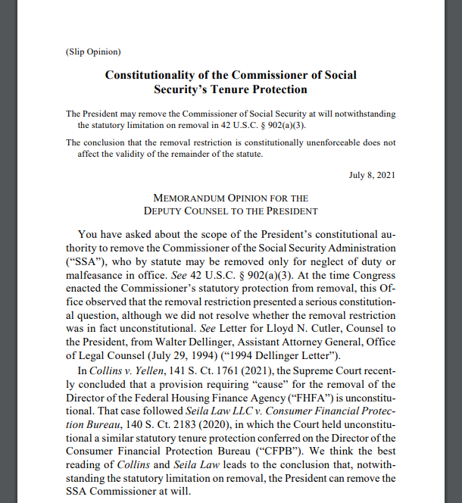
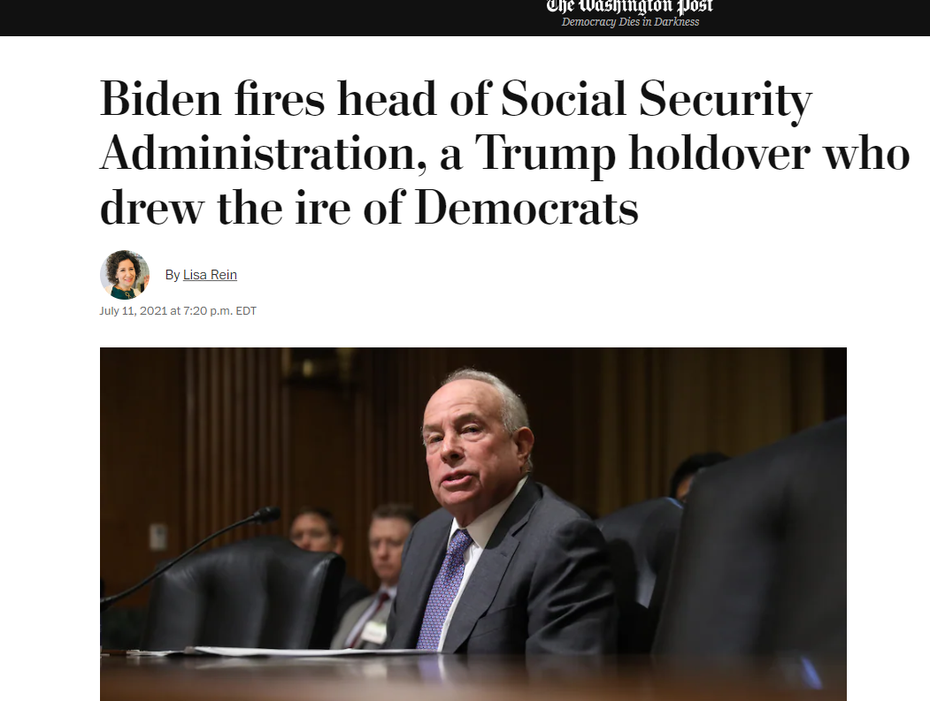
Aftermath in the Biden Administration

